Slide 1
Adolescence and Hirsutism
Prof. Maysoon Sharief, D.G.O., C.A.B.O.G
Department of Gynecology & Obstetrics,
University of Basrah,
Basrah, Iraq.

Slide 2
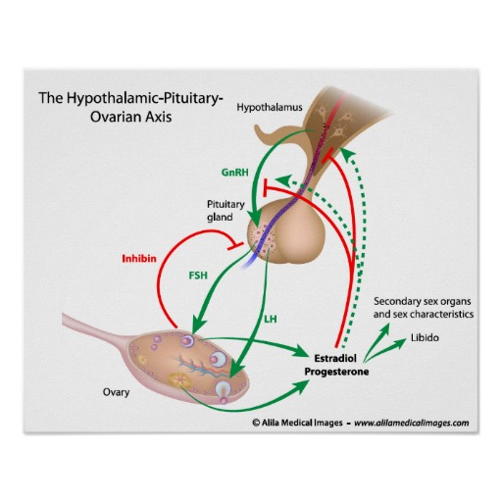
Introduction
Hirsutisum
The entire body is covered with
Different types of hair in different site
Androgens are involved in sebum
Production.
Androgens affect some areas of human body and increase hair growth rate and the thickness of terminal hairs

Slide 3
Causes of hirsutism in adolescents
1- Androgenic causes :-
Congenital adrenal hyperplasia
- Classic
- Late onset
2- Androgen- secreting tumours
3- Polycystic ovarian syndrome
4- Idopathic
5- XY gonadal dysgenesis
6- Constitutional basis ,familial.

Slide 4
Presentation of hirsutism
1- Hirsutism alone (need dermatologist)
2- Hirsutism and associated pilosebaceous over activity(more in teenage girls)
3- Hirsutism and ovulatory disorders.(comes mostly to gynecology)
4- Hirsutisum and signs virilization (need immediate work-up)

Slide 5
Treatment
The most effective strategy is to combine systemic therapy which has a slow onset effectiveness with mechanical depilation( shaving, plucking, waxing ,depilatory creams) or light- based(laser or pulsed- light) hair removal
1- Systemic therapies
a- decrease ovarian or adrenal production like OCS, spironolactones,
b- flutamide potent nonsteroidal selective antiandrogen

Slide 6
3- Cyproterones
4- Insulin sensitizers
5- Cosmetic measures
disadvantages:- hydrogen peroxide bleaching is not suitable for severe hirsutisum
Plucking can cause skin irritation, folliculitis
Waxing can cause skin irritation
Shaving may be psychological unacceptable
Chemical depliatones can cause skin irritation

Slide 7
Treatment
Treatment for hirsutism is the same in adult
In the adolescence the main stay in the treatment of androgen excess has been the oral contraceptive pill.
The girls with PCO need ovarian suppression and lowering circulating androgens.

